Slide 1
Amazon Web Services
Infrastructure

Slide 2
The cloud and the datacenter
The so called cloud is actually a large quantity of computing and networking resources located in multiple datacenters.
The cloud provides an interface to customers to request and use portions of those resources.
From the viewpoint of the customer, it is opaque what happens inside the “cloud”.
The customer obtains resource allocation on demand and pays per usage.

Slide 3
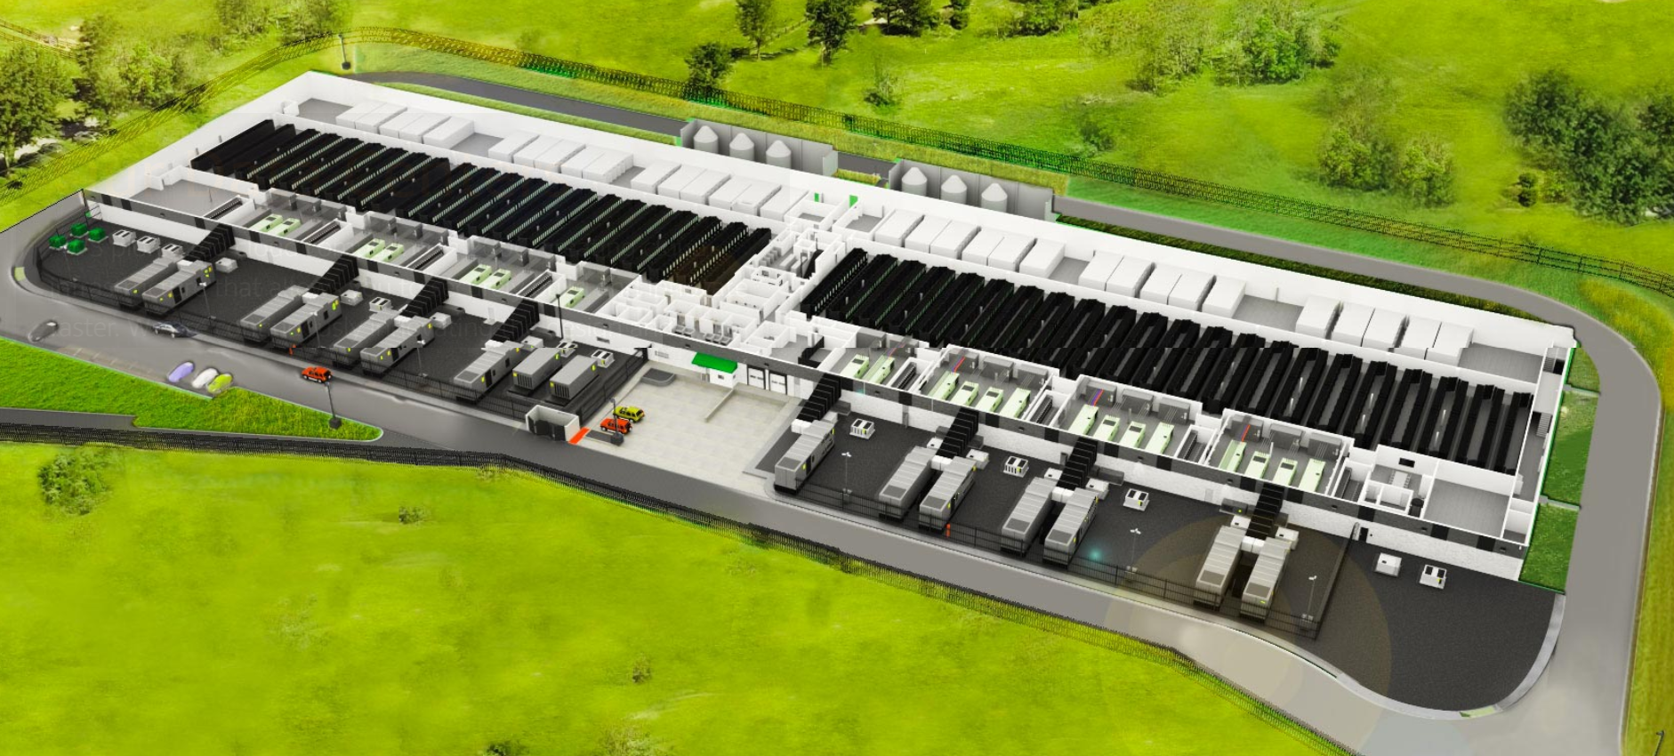
AWS model datacenter aerial view
Source: https://aws.amazon.com/compliance/data-center/data-centers/

Slide 4
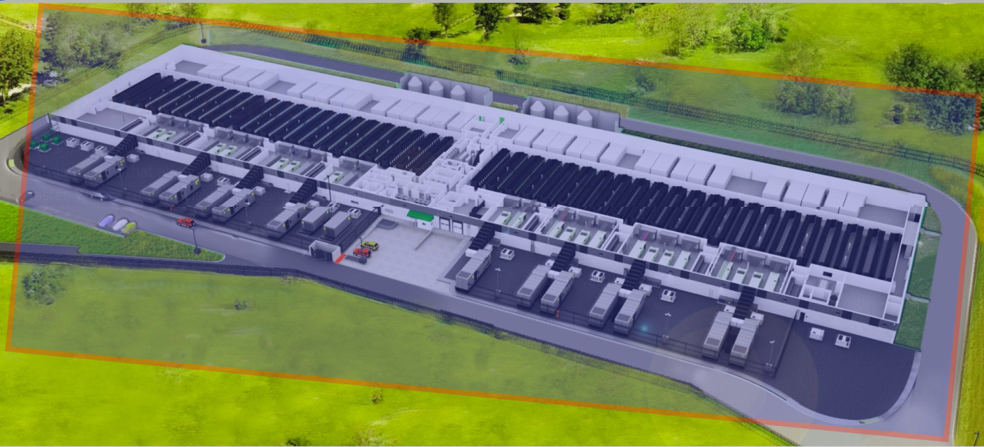
Perimeter Layer
The first level of security of a datacenter is the physical perimeter.
The highlighted area shows the secured perimeter with barriers preventing physical intrusion.

Slide 5
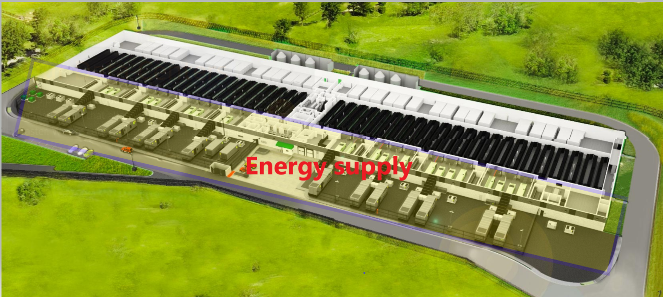
Infrastructure Layer
The datacenter is provisioned to sustain its own electrical energy generation.
The highlighted area contains power generators, converters AC/DC, and batteries.
AWS surrounds its datacenter with wind and solar farms to supply electrical energy.

Slide 6
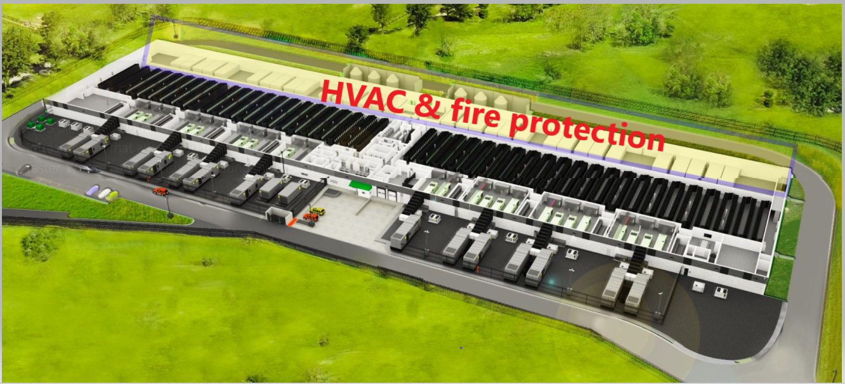
Infrastructure Layer
HVAC and fire suppression:
Controlling the temperature and humidity of the DC is the biggest infrastructure challenge in any datacenter.
The vast accumulation of equipment generates heat that needs to be dissipated.
The place is always at risk of fire, so an automated fire suppression system is ready to respond to fire incidents.

Slide 7
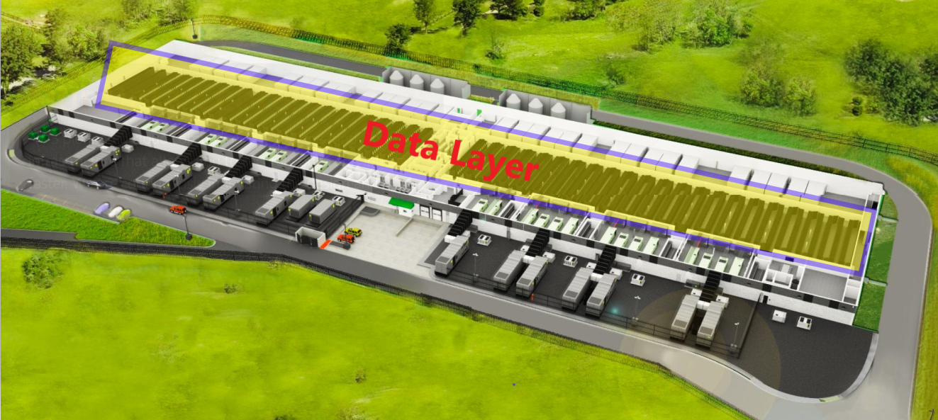
Data Layer
The so called AWS data layer are rows and rows of computing and networking equipment.
Thousands of servers, LAN switches, routers, firewalls and other devices conform the core of the cloud.
All of the customers services are virtualized, someplace, in physical servers and networking equipment.

Slide 8
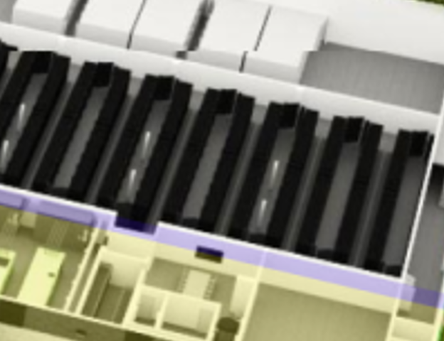
Data Layer
The so called AWS data layer are rows and rows of computing and networking equipment.
(In the picture, I counted 22 aisles of double rows on each side for a total of 88 rows).
Let’s take one aisle to see it in more detail.
Expanded view

Slide 9
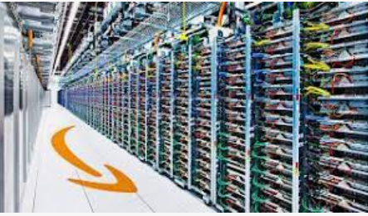
Data Layer
One aisle in more detail.
Each row has a number of racks.
Each rack has a number of blade servers on it.
Each server holds even more virtual servers and containers.
Expanded view

Slide 10
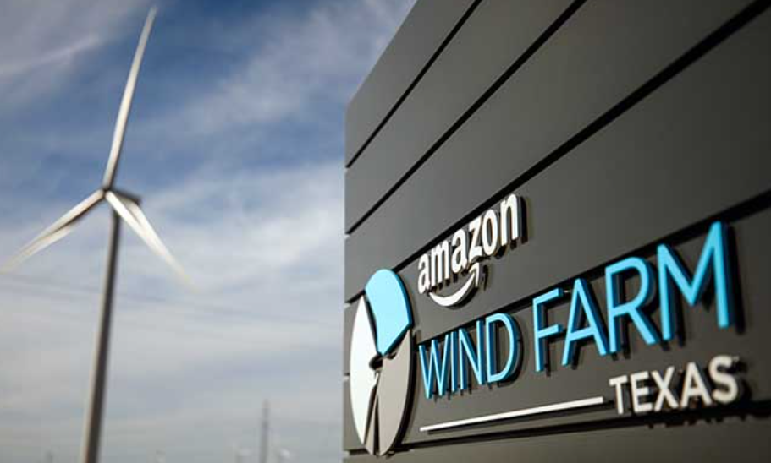
Environmental Layer:
Datacentres are massive consumers of electrical energy.
There are several levels of energy supply to a datacenter:
Public grid
Own generators
AWS surrounds several of its datacenters with wind and solar farms to supply electrical energy.
Source: https://datacenterfrontier.com/amazon-buys-green-power-to-speed-shift-to-renewable-aws-cloud/
(Photo: Jordan Stead/ Amazon)

Slide 11
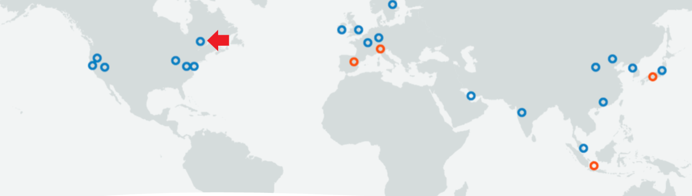
AWS Regions
An AWS region is a geographical cluster of datacenters.
By December 2020, AWS had 22 regions across the world.
For example, for now, Canada has one region called Central with datacenters located in the Montreal Metropolitan Region.
Regions contain Availability Zones.
Source: https://aws.amazon.com/blogs/aws/now-open-third-availability-zone-in-the-aws-canada-central-region/

Slide 12
AWS Regions
An AWS region is a geographical cluster of datacenters.
By September 2021, AWS had 25 regions across the world.
Regions contain Availability Zones.
Source: https://aws.amazon.com/about-aws/global-infrastructure/

Slide 13
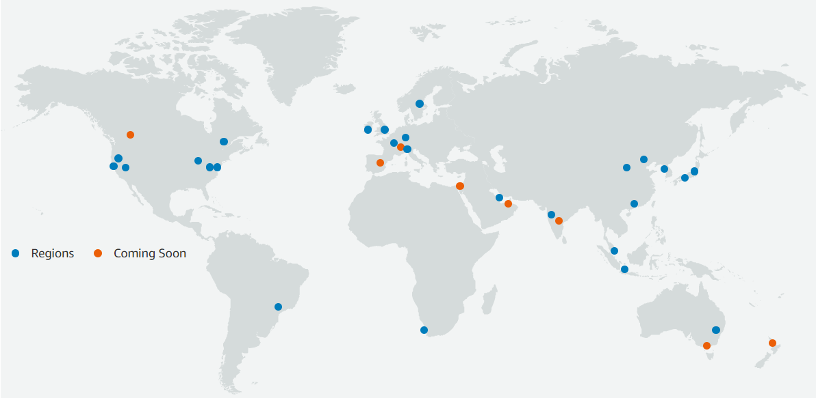
AWS 26 Regions, 84 availability zones. May 2022
Calgary
Montreal

Slide 14
AWS Regions
Regions imply more than just a geographical location.
In many cases, choosing a region has to do with legal conditions such as jurisdiction laws.
Some AWS services are only offered in certain regions due to regulations and country laws.
The location of a service might be determined by the traffic interests also. For example, a video streaming service should be close to the local customers.

Slide 15
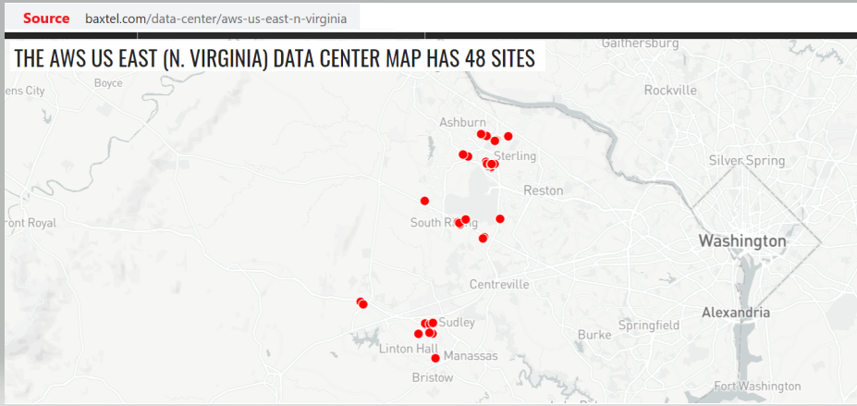
The U.S East North Virginia Region is the AWS default region

Slide 16
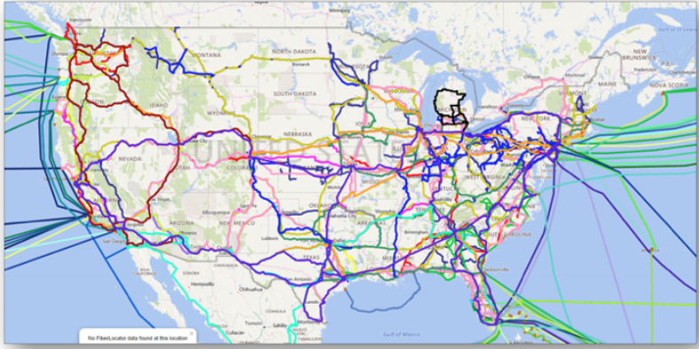
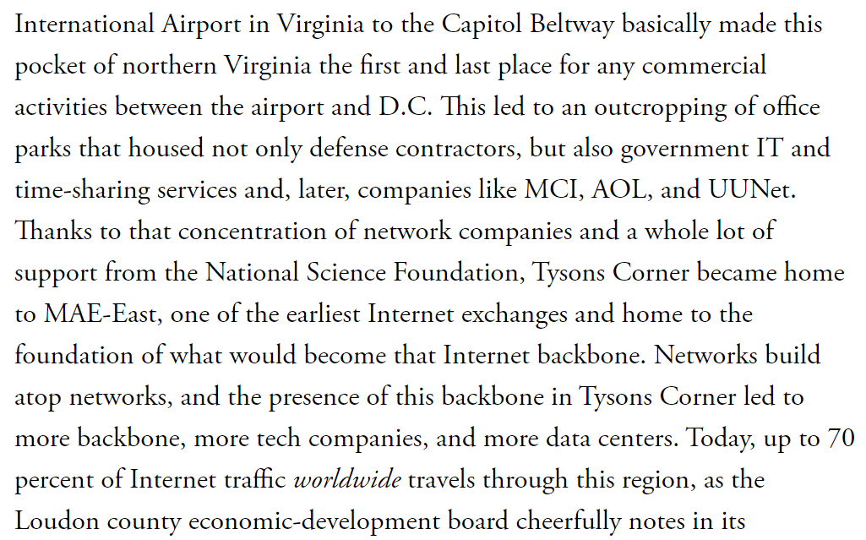
U.S East Region
The East Region accounts for most of the Internet traffic in the U.S (and the world)
It is close to the seat of the U.S government too and many telecom and tech headquarters.
There are historical reasons too. (see reference:
https://www.theatlantic.com/technology/archive/2016/01/amazon-web-services-data-center/423147/
The state and municipalities in Virginia have been receptive to the installation of the data centres.
Reference: https://blsstrategies.com/hyperscaledatacenters

Slide 17
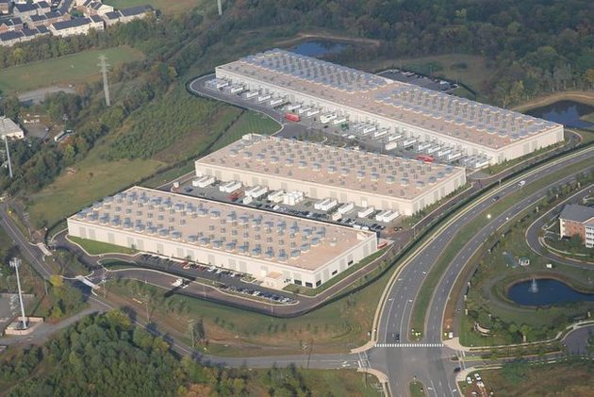
AWS datacenters IAD-50, IAD-60 and IAD-71 in N. Virginia
Source: https://baxtel.com/data-center/aws-us-east-n-virginia

Slide 18
Availability Zones
An Availability Zone is one or more datacenters with redundant power, networking, and connectivity inside an AWS Region.
The main idea is to provide redundancy and load distribution.
The datacenters are linked with low latency links. (high-capacity optical fibre).
In case of failure in one DC, other DCs can handle the workload.
For example, Canada has only one region called Canada Central Region with three AZ (by December 2020).
The datacenters are in the Montreal Area.
Source: https://aws.amazon.com/blogs/aws/now-open-third-availability-zone-in-the-aws-canada-central-region/
Source: https://aws.amazon.com/about-aws/global-infrastructure/regions_az/#Regions

Slide 19
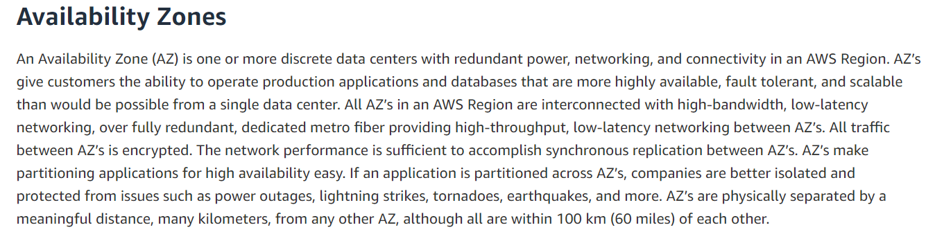
Availability Zones AWS official definition

Slide 20
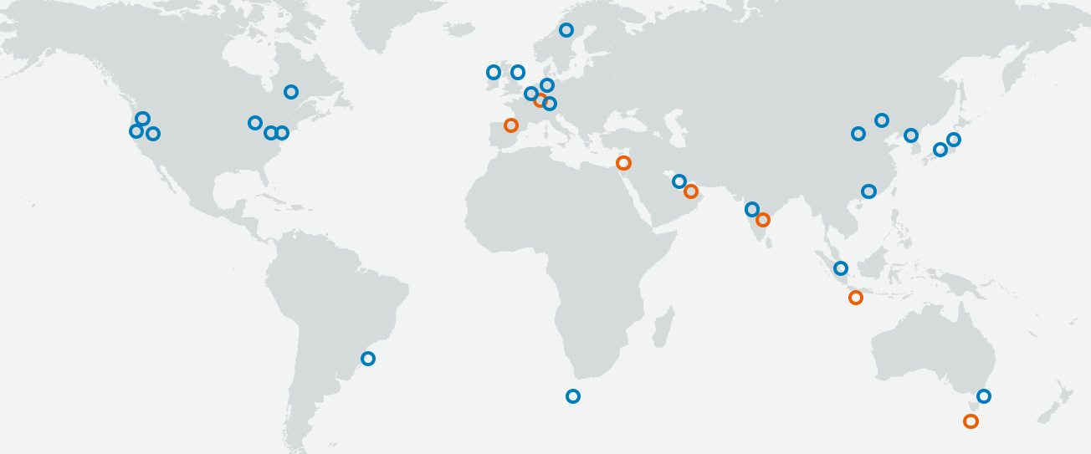
September 2021
The AWS Cloud spans 25 geographic regions around the world with 81 Availability Zones.
Announced plans for additional 7 more AWS Regions.
Announced plans for additional 21 more Availability Zones.

Slide 21
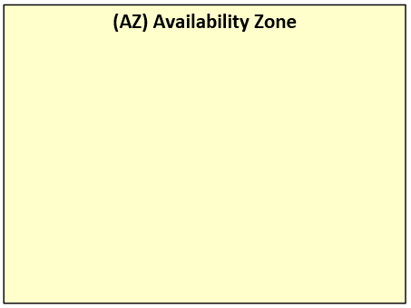
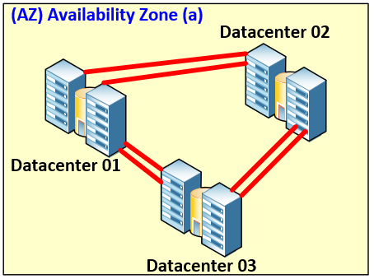
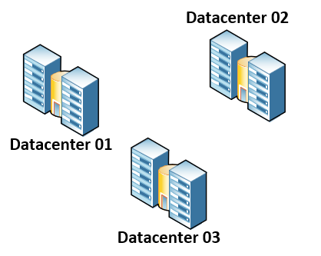
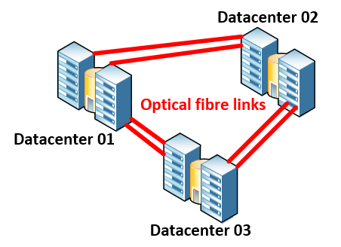
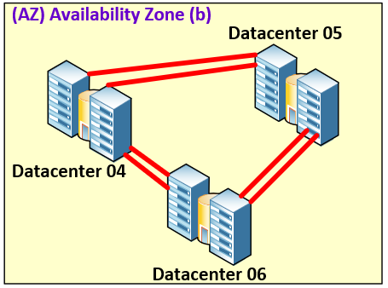
Region

Slide 22
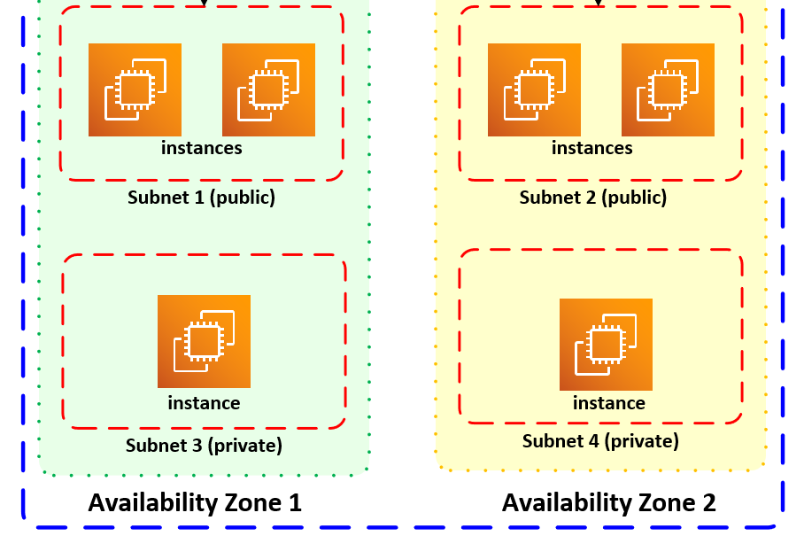
In this example, a tenant duplicates its infrastructure into two Availability Zones in the same Region.

Slide 23
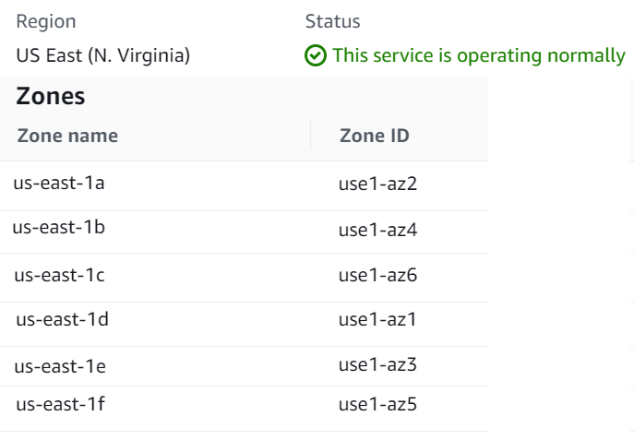
US East region (North Virginia)
This region is the original AWS.
It contains six (6) availability zones (AZ) shown in the annexed list.
This AZ are highly interconnected to enable multiple redundancy of services.
This is typically the region where AWS first deploys new services.

Slide 24
Extension of the availability zone concept
AWS is pushing to place services as close to the end user as possible.
That means that some services are not exclusively located in the AWS datacenters but on premises.
AWS have designed several specific models for such special cases:
AWS Local Zones
AWS Outposts
AWS Wavelength
Reference: https://aws.amazon.com/about-aws/global-infrastructure/regions_az/#Regions

Slide 25
AWS Local Zones
Local zones are extensions of Amazon AWS that deploys AWS compute, storage, database, resources and services in proximity to some large population, important industry, and IT centers.
Local zones are only available in Los Angeles, Boston, Miami and Houston at the time of this writing (September 2021).
The concept of local zones seems to be superseded by AWS outposts.

Slide 26
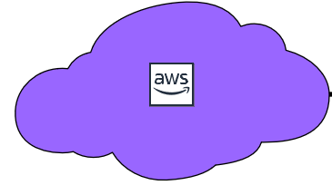
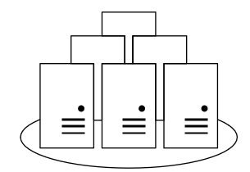
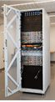
AWS Outpost
Customer’s on-prem datacenter

Slide 27
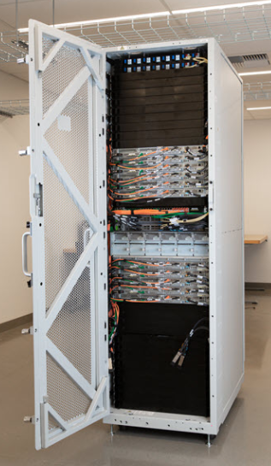
AWS Outpost
An outpost is an extension of the AWS cloud inside the customer’s premises.
Amazon places a rack with compute, storage, and network devices on the customer location.
The rack and the devices on it are specially designed by AWS
The services and tools available are the same as in the AWS cloud.
An outpost comes in different formats.
Starting from one 1U server size, 2U server, a 42U rack, up to 96 racks of 42 units.
There are many applications for outposts.
Source: https://aws.amazon.com/outposts/
Picture: https://aws.amazon.com/blogs/aws/aws-outposts-now-available-order-your-racks-today/
Nice to watch: https://www.youtube.com/watch?v=Q6OgRawyjIQ&feature=emb_title

Slide 28
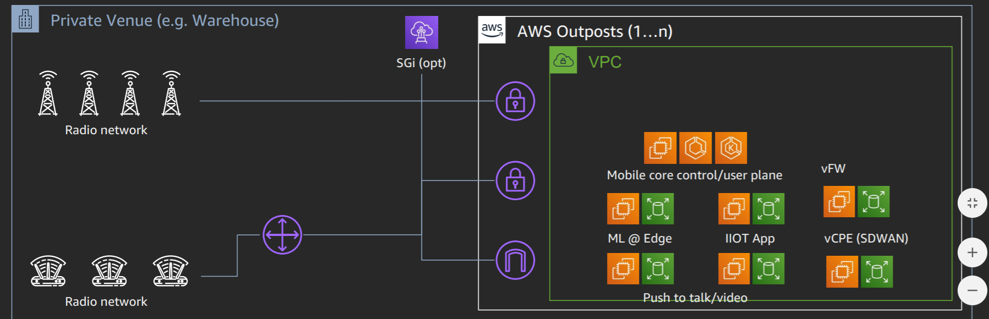
AWS Outpost
One driving need behind the outpost concept is that the customer runs “workloads” that require low latency.
Applications such as AI, augmented reality and others that require extreme low latency.
For example, a cell phone carrier needs to deploy applications close to their service radio cells (the edge).
Source: https://d1.awsstatic.com/events/reinvent/2019/Industry_4.0_with_mobile_edge_network_services_powered_by_AWS_Outposts_TLC305.pdf

Slide 29
AWS Outpost
Another use case for outposts is when the workloads are deeply ingrained with the customer systems.
For example, in-house applications that are difficult to migrate to the cloud.
The customer can keep its IPv4 address space with outposts.
The idea of outpost is a big part of AWS strategy to help companies to migrate their services into the cloud.
As a transition strategy, the customer can start migrating services in a progressive manner.
Another use of outposts is when regulation forces an organization to keep physical control of data.
Source: https://aws.amazon.com/outposts/
Picture: https://aws.amazon.com/blogs/aws/aws-outposts-now-available-order-your-racks-today/

Slide 30
AWS wavelength
AWS Wavelength is an extension of the idea of outposts but only applied to cellular 5G networks.
AWS wavelength is defined as an AWS Infrastructure optimized for mobile edge computing applications which is embedded within the telco 5G providers datacenters.
The result is that the latency between the customer devices and the applications is super low.

Slide 31
Strategically
Furthermore, Amazon intention is to keep expanding its realm toward the customers by creating its own backbone network bypassing the telco carriers for some cases. (for now)

Slide 32
Interesting quotes.
…“The actual infrastructure at the heart of AWS’ infrastructure-as-a-service isn’t the thing that makes it important to developers; it’s the services and APIs built on top of that infrastructure”…
…”Amazon didn’t invent the principles behind cloud computing, but they made the infrastructure of cloud computing into a dirt-cheap commodity”…
Reference (September 2021): https://www.theatlantic.com/technology/archive/2016/01/amazon-web-services-data-center/423147/

